Slide 1
3D Image Segmentation and Quantification of Lysosomes
8/12/2025

Slide 2
FILES
40A_UAS-TMEM1923x-HA x 71G10 40A MARCM_L3_1_Airy_010724
40A_UAS-TMEM1923x-HA x 71G10 40A MARCM_L3_2_Airy_010724
40A_UAS-TMEM1923x-HA x 71G10 40A MARCM_L3_4_airy_020724
Airy scan_40A_UAS-TMEM-HA_CB_0h_1_051222
Airy scan_40A_UAS-TMEM-HA_CB_0h_2_051222
Airy scan_40A_UAS-TMEM-HA_CB_4h_1_051222
Airy scan_40A_UAS-TMEM-HA_CB_4h_2_051222
AiryScan-UAS-GFP cyto_40A_UAS-TMEM-3xHA_CB_6h_2_300423.tif
TMEM-HA 6h CB airy_3_170722
40A_UAS-TMEM192-3xHA x 40A 71G10 MARCM_around 12h - for quantification_4 Airy-CBs_300425
40A_UAS-TMEM192-3xHA x 40A 71G10 MARCM_around 12h - for quantification_3 Airy-CBs_300425
40A_UAS-TMEM192-3xHA x 40A 71G10 MARCM_around 12h - for quantification_5_Airy_CBs_040525

Slide 3
40A_UAS-TMEM1923x-HA x 71G10 40A MARCM_L3_1_Airy_010724

Slide 4
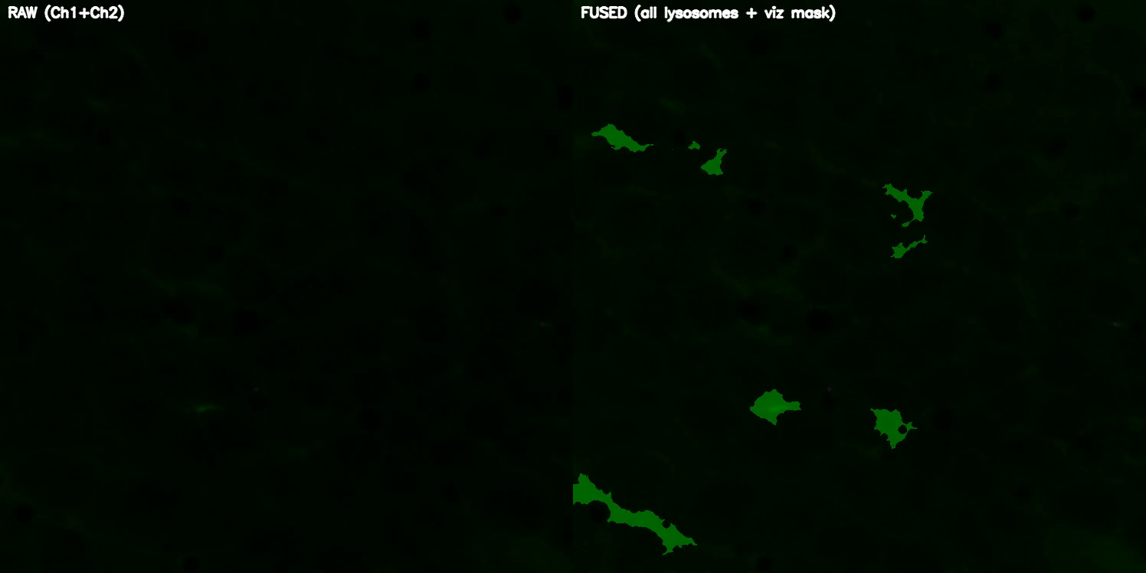
DETECTION VIDEO

Slide 5
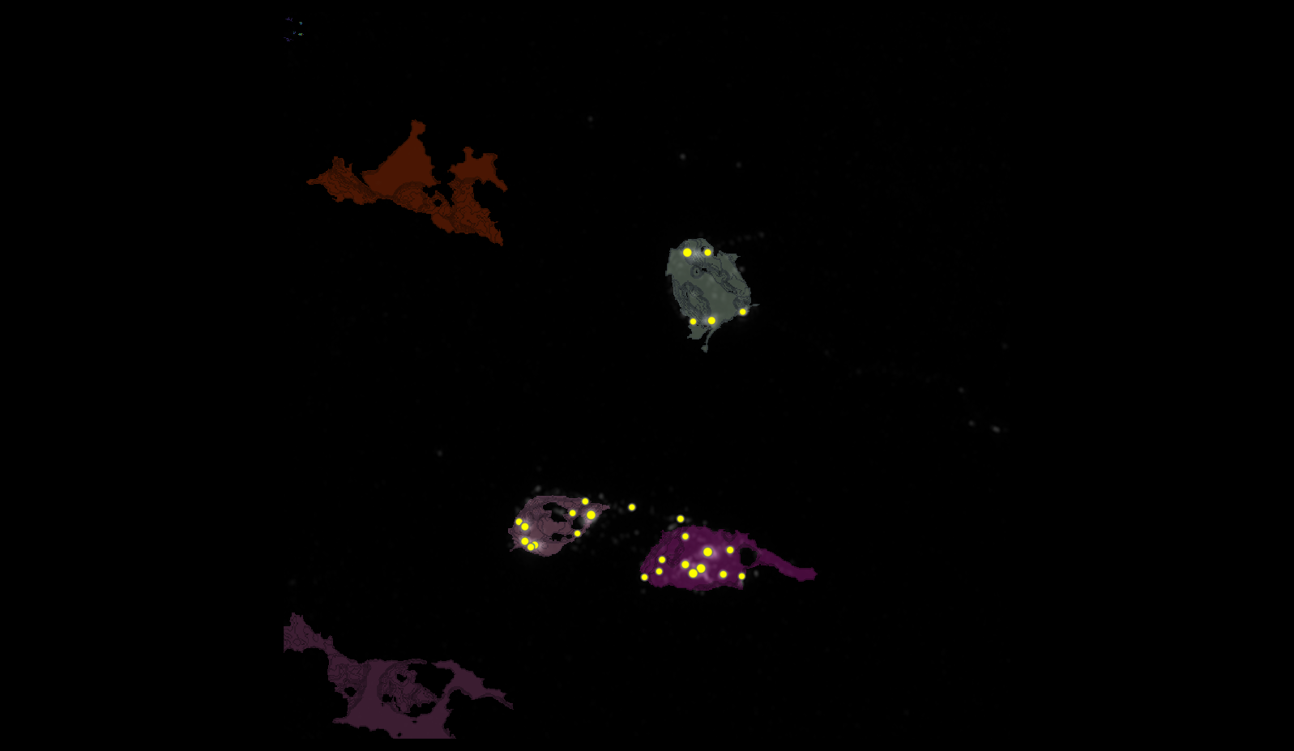
SEGMENTATION
2
3
4

Slide 6
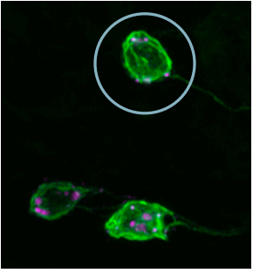
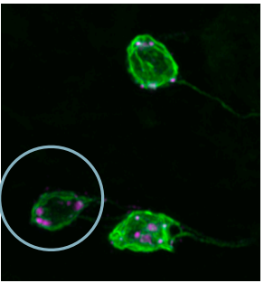
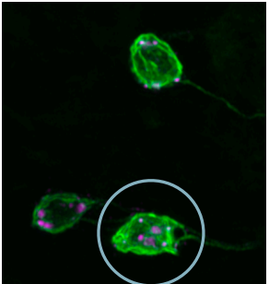
MANUAL.vs.AUTOMATIC
2
3
4

Slide 7
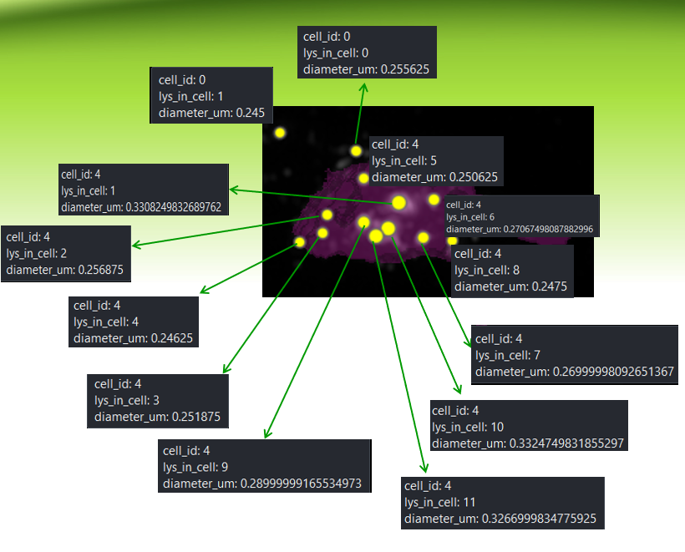
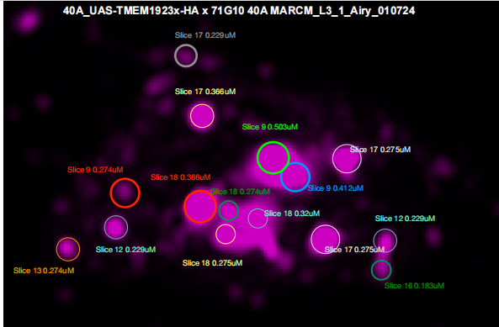
MANUAL.vs.AUTOMATIC
4
1
0
6
5
1
2
4
9
10
8
3
7
11
OUTSIDE(ID lysosomes)
INSIDE(ID lysosomes)

Slide 8
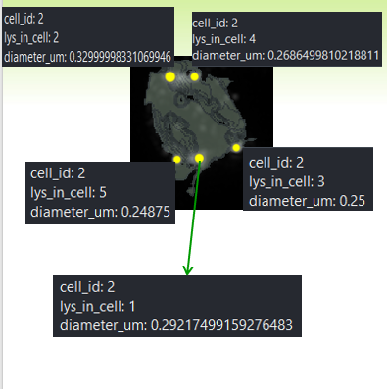
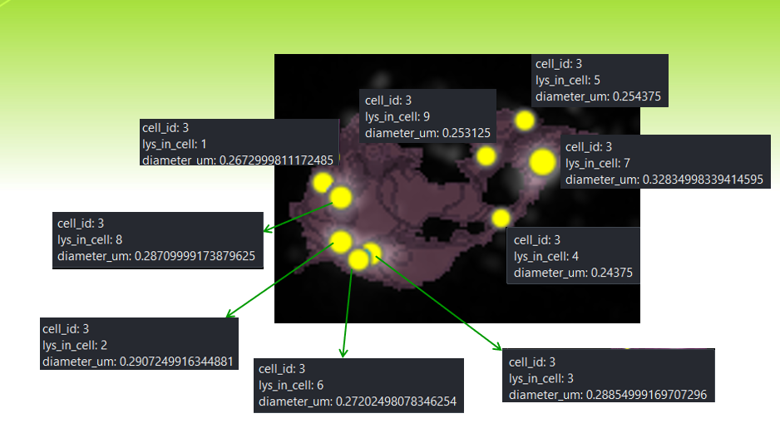
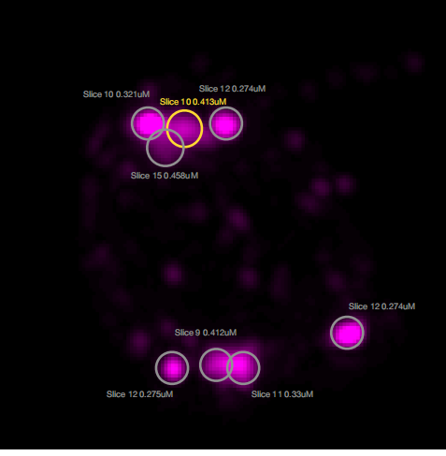
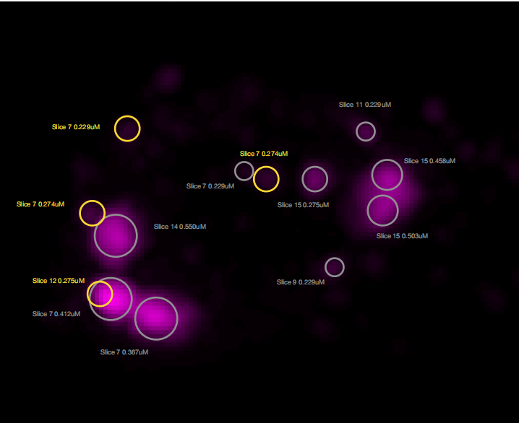
MANUAL.vs.AUTOMATIC
3
2
2
4
5
9
1
7
2
8
3
4
5
6
3
1

Slide 9
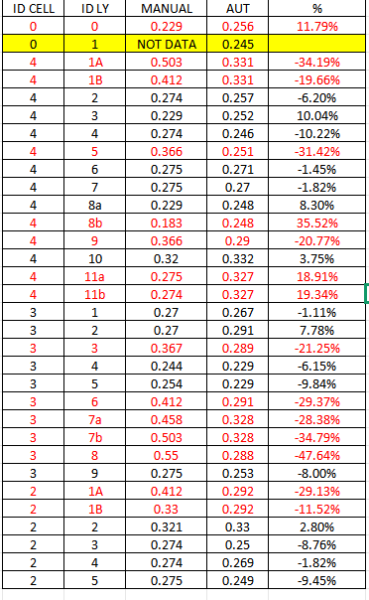
MANUAL.vs.AUTOMATIC

Slide 10
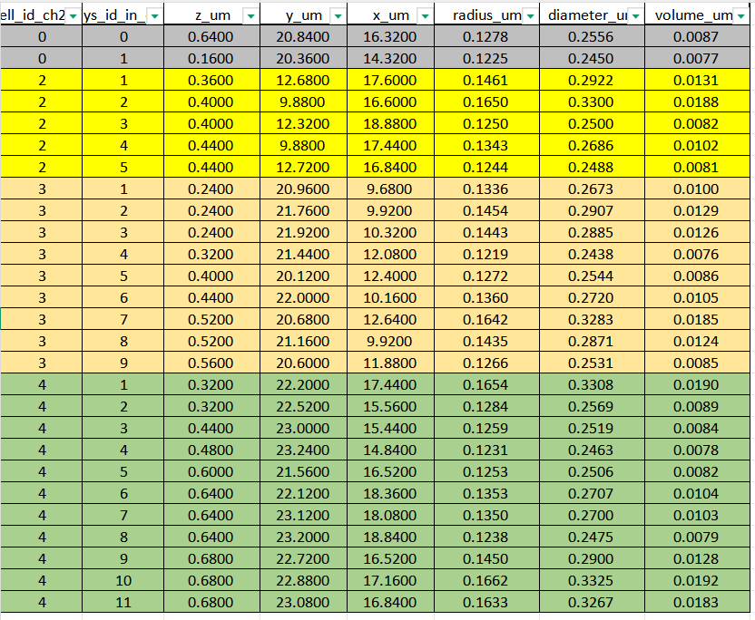
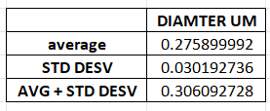
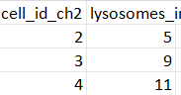
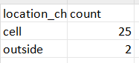
DATASET LYSOSOMES(ORDER FOR CELL ID)

Slide 11
40A_UAS-TMEM1923x-HA x 71G10 40A MARCM_L3_2_Airy_010724

Slide 12
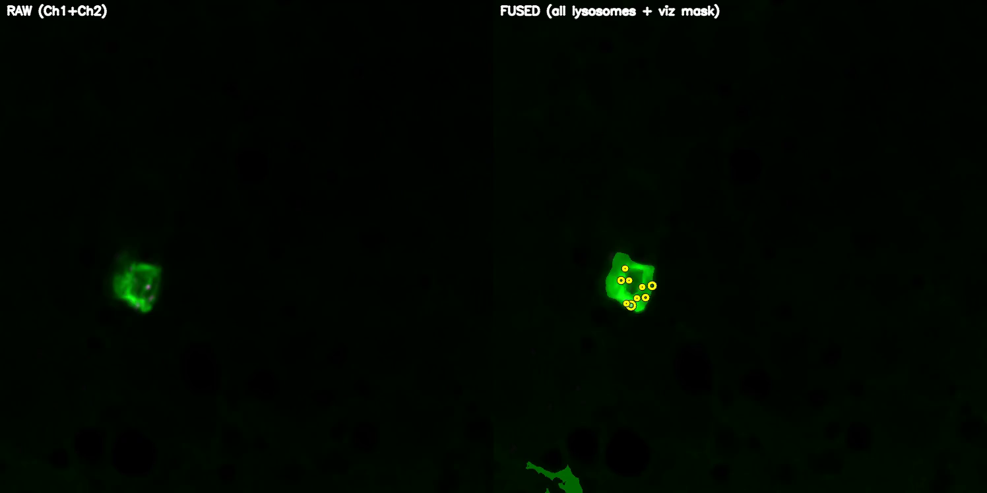
DETECTION VIDEO

Slide 13
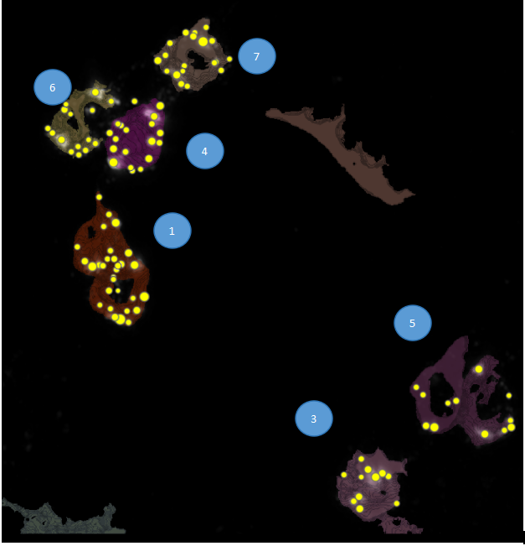
SEGMENTATION

Slide 14
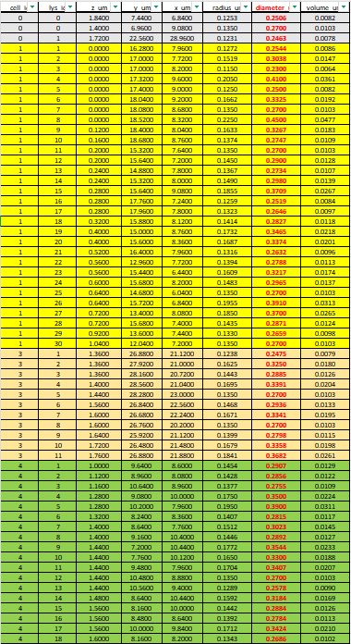
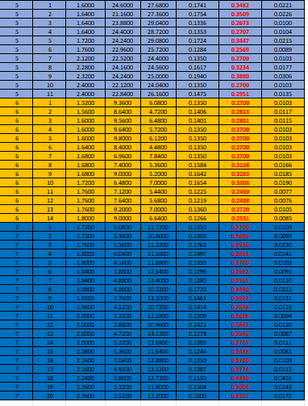
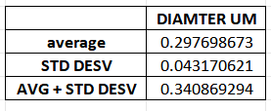
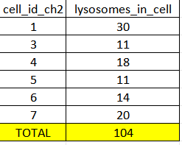
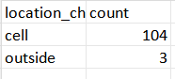
DATASET LYSOSOMES(ORDER FOR CELL ID)

Slide 15
40A_UAS-TMEM1923x-HA x 71G10 40A MARCM_L3_4_airy_020724

Slide 16
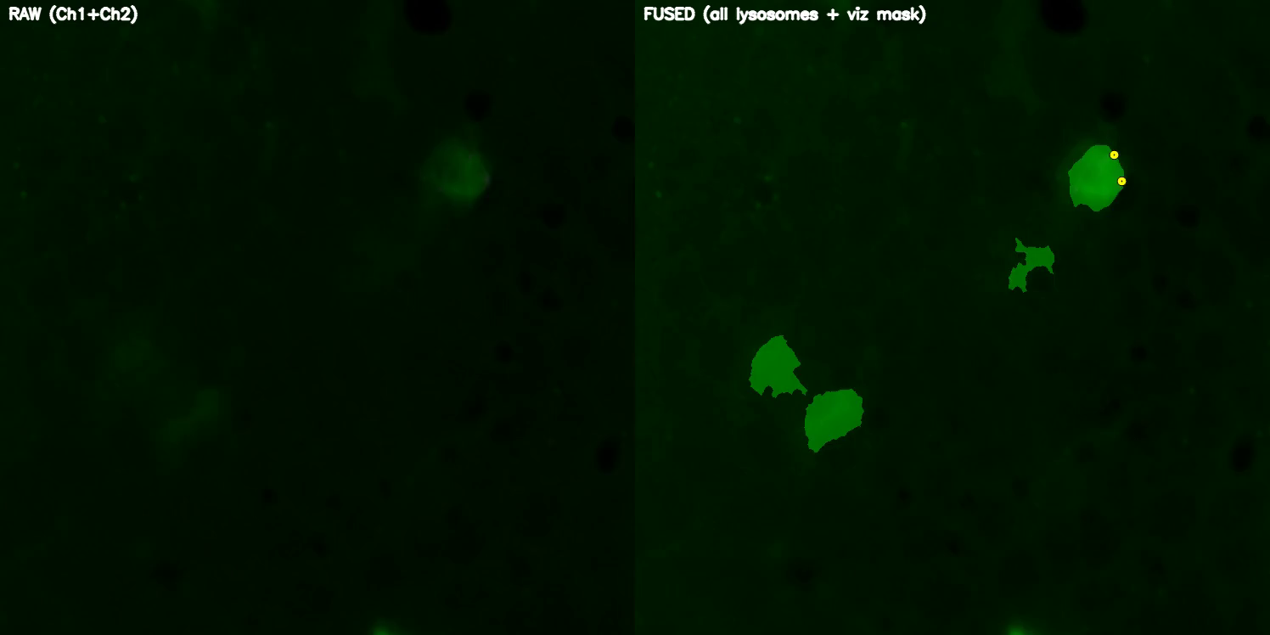
DETECTION VIDEO

Slide 17
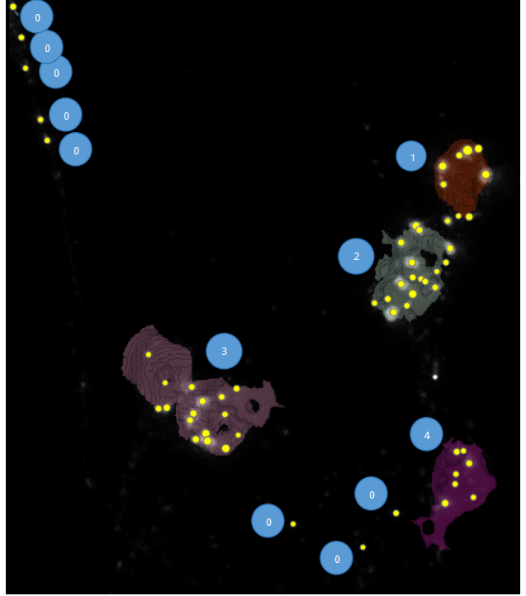
SEGMENTATION

Slide 18
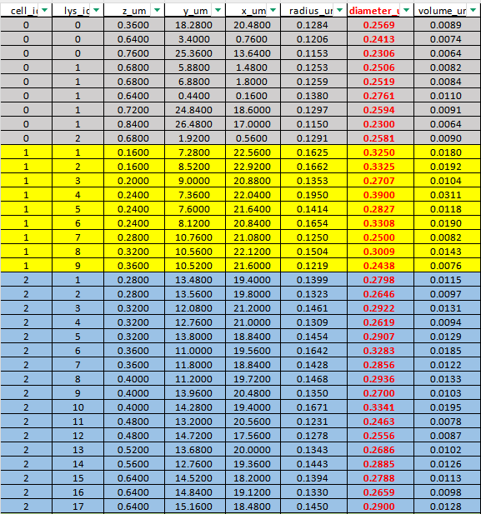
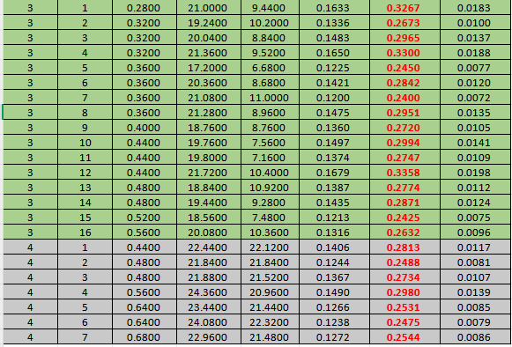
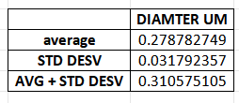
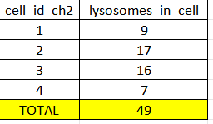
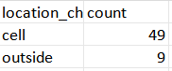
DATASET LYSOSOMES(ORDER FOR CELL ID)

Slide 19
Airy scan_40A_UAS-TMEM-HA_CB_0h_1_051222

Slide 20
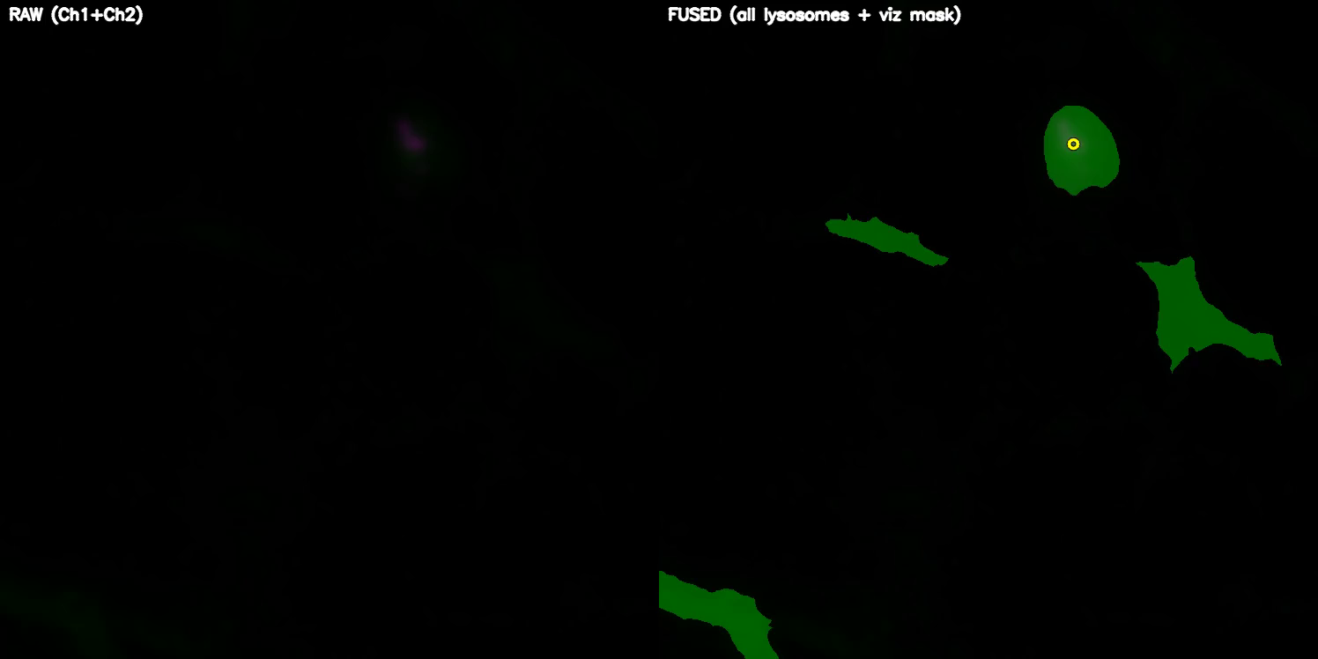
DETECTION VIDEO

Slide 21
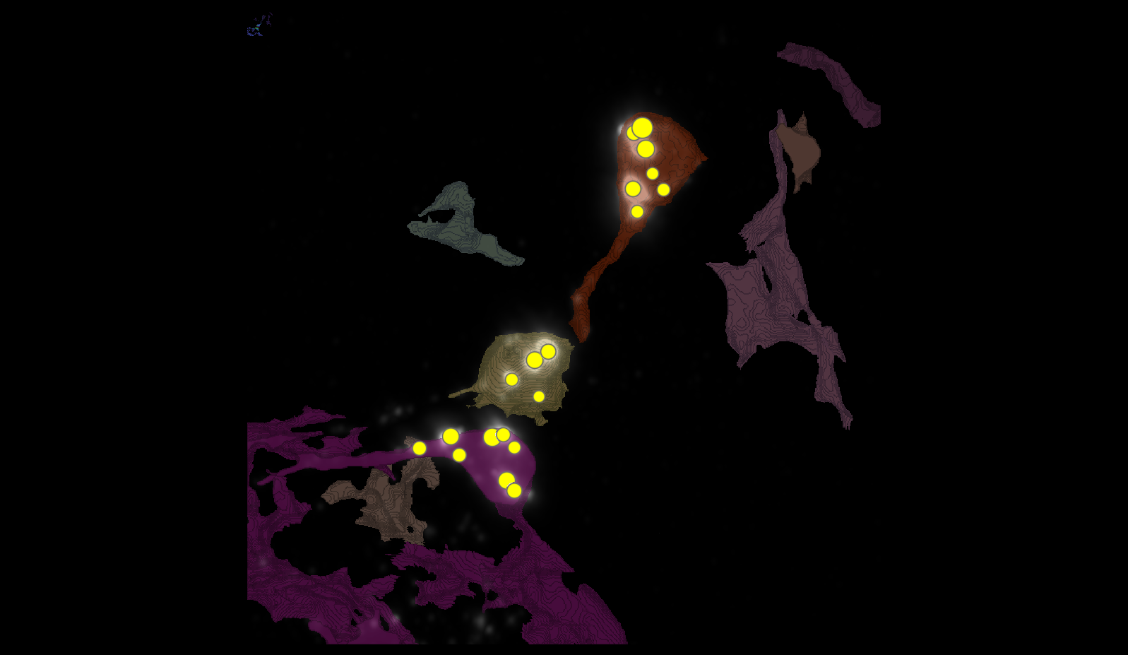
SEGMENTATION

Slide 22
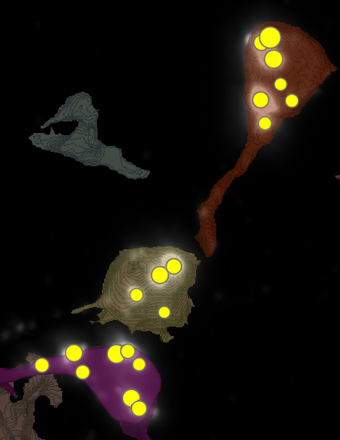
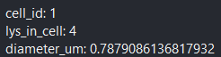
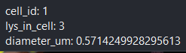
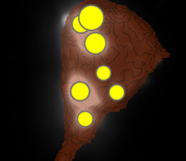
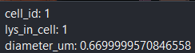
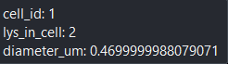
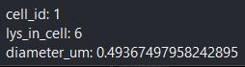
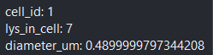
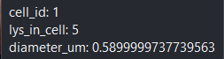
METRICS
1
6
4

Slide 23
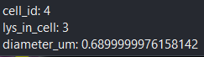
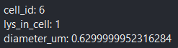
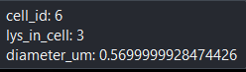
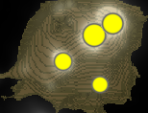
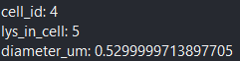
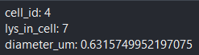
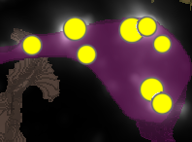
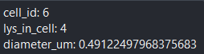
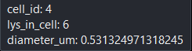





METRICS

Slide 24



MANUAL.vs.AUTOMATIC
4
6
1

Slide 25


MANUAL.vs.AUTOMATIC
3
7
3
5
1
4
8
4
2
1
2

Slide 26

MANUAL.vs.AUTOMATIC
4
3
1
2
5
6
7

Slide 27

MANUAL.vs.AUTOMATIC

Slide 28




DATASETS

Slide 29
Airy scan_40A_UAS-TMEM-HA_CB_0h_2_051222

Slide 30

DETECTION VIDEO

Slide 31

SEGMENTATION
1
4
2
3

Slide 32


















MANUAL.vs.AUTOMATIC
1
4
2
2
1
3
5
5
4
3
1
6
4
6

Slide 33

MANUAL.vs.AUTOMATIC

Slide 34




DATASET LYSOSOMES(ORDER FOR CELL ID)

Slide 35
Airy scan_40A_UAS-TMEM-HA_CB_4h_1_051222

Slide 36

DETECTION VIDEO

Slide 37

SEGMENTATION
4
5
2
3

Slide 38


























METRICS
4
1
2
3

Slide 39






MANUAL.vs.AUTOMATIC
6
3
8
4
4
7
5
6
5
1
2
7
1
3
2
4

Slide 40

MANUAL.vs.AUTOMATIC

Slide 41




DATASETS

Slide 42
Airy scan_40A_UAS-TMEM-HA_CB_4h_2_051222

Slide 43

DETECTION VIDEO

Slide 44

SEGMENTATION
2
3
6

Slide 45




























METRICS

Slide 46




MANUAL.vs.AUTOMATIC
3
2

Slide 47


MANUAL.vs.AUTOMATIC
4
6
3
4
8
3
1
11
2
7
7
12
5
6

Slide 48

MANUAL.vs.AUTOMATIC

Slide 49




DATASETS

Slide 50
AiryScan-UAS-GFP cyto_40A_UAS-TMEM-3xHA_CB_6h_2_300423.tif

Slide 51




SEGMENTATION
3
0-1
0-3
1
2
0-0

Slide 52



MANUAL.vs.AUTOMATIC
1
2
3

Slide 53









MANUAL.vs.AUTOMATIC
5
2
4
0-1
1
3
1

Slide 54









MANUAL.vs.AUTOMATIC
2
1
7
6
2
4
5
3

Slide 55








MANUAL.vs.AUTOMATIC
3
2
1
4
3
5
0-3

Slide 56

MANUAL.vs.AUTOMATIC

Slide 57




DATASET LYSOSOMES(ORDER FOR CELL ID)

Slide 58
TMEM-HA 6h CB airy_3_170722

Slide 59

DETECTION VIDEO

Slide 60

SEGMENTATION
24
2
9
8
6
7
15
1
3
5

Slide 61





MANUAL.vs.AUTOMATIC

Slide 62

MANUAL.vs.AUTOMATIC

Slide 63





DATASET LYSOSOMES(ORDER FOR CELL ID)

Slide 64
40A_UAS-TMEM192-3xHA x 40A 71G10 MARCM_around 12h - for quantification_4 Airy-CBs_300425

Slide 65

DETECTION VIDEO

Slide 66

SEGMENTATION

Slide 67




MANUAL.vs.AUTOMATIC + DATASET LYSOSOMES
1 CELL, 3 LYSOSOMES

Slide 68
40A_UAS-TMEM192-3xHA x 40A 71G10 MARCM_around 12h - for quantification_3 Airy-CBs_300425

Slide 69

DETECTION VIDEO

Slide 70

SEGMENTATION
2
18
35
39
38
65

Slide 71



MANUAL.vs.AUTOMATIC

Slide 72

MANUAL.vs.AUTOMATIC

Slide 73




DATASET LYSOSOMES(ORDER FOR CELL ID)

Slide 74
40A_UAS-TMEM192-3xHA x 40A 71G10 MARCM_around 12h - for quantification_5_Airy_CBs_040525

Slide 75

DETECTION VIDEO

Slide 76









SEGMENTATION

Slide 77




DATASET LYSOSOMES(ORDER FOR CELL ID)

Slide 78

DATA ALL IMAGES
L:I use a average between L3-1, L3-2 and L3-4.
0H: I use a average between 0H-1 and 0H-2.
4H: I use a average between 4H-1 and 4H-2.
6H: I use a average between 6H-2 and 6H-3.
12H: I use a average between 12H-3,12H 4 and 12H-5.

Slide 79


PLOT #LYSOSOMES/#CELLS

Slide 80


PLOT VOL LYSOSOMES/ VOL CELLS

